Slide 1
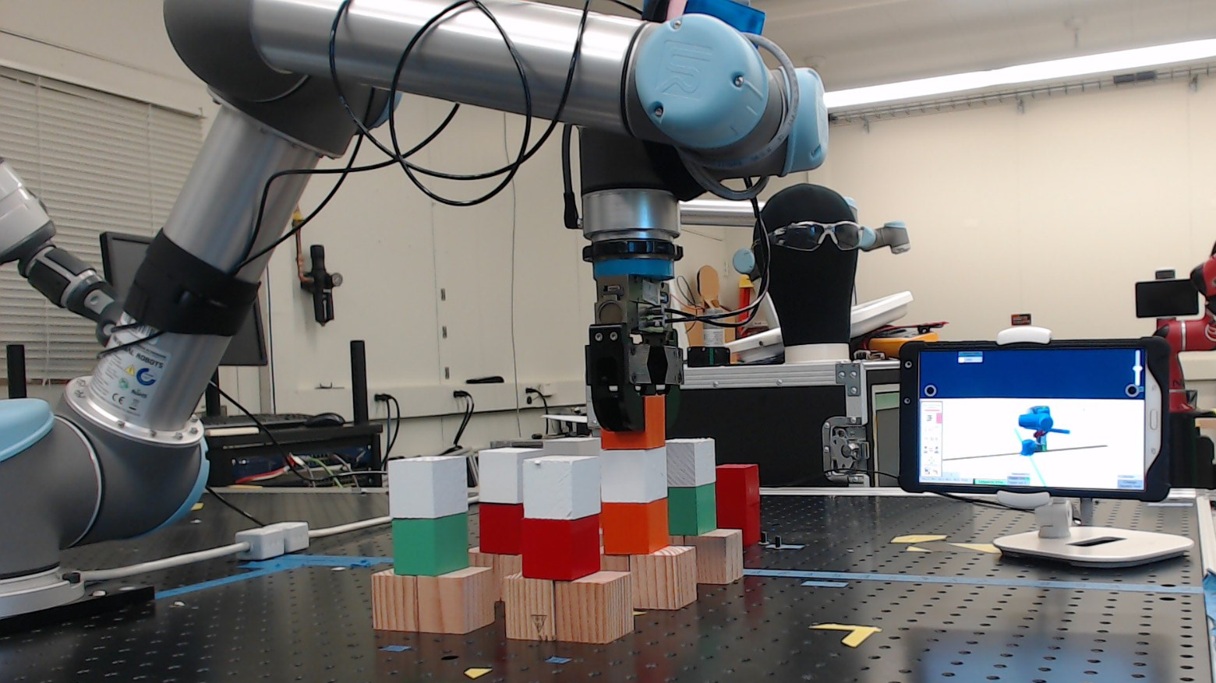
Adaptive Metrics and Performance Analysis Tool for Human-Robot Interaction
Author: Esteban Segarra Martinez;
Mentors: Shelly Bagchi, Dr. Jeremy Marvel, Megan Zimmerman

Slide 2
Introduction
Collaborative robots are robots that are safer to use with a task in collaboration with a human in a manufacturing task
When a user uses a robot, they use an industrial controller known as a human-machine interface (HMI)
NIST is interested in producing test methods to measure the interaction from using a robot, the human-robot interaction (HRI), from using a system from the perspective of a novice user
Figure 1 – Human-robot interaction
NIST Engineering Laboratory
Notes:
Collaborative robots are safer through the use of force-limited motors and sensors that allow a robot to work in collaboration with a human.
These robots will avoid causing serious harm to a user in case of an error

Slide 3
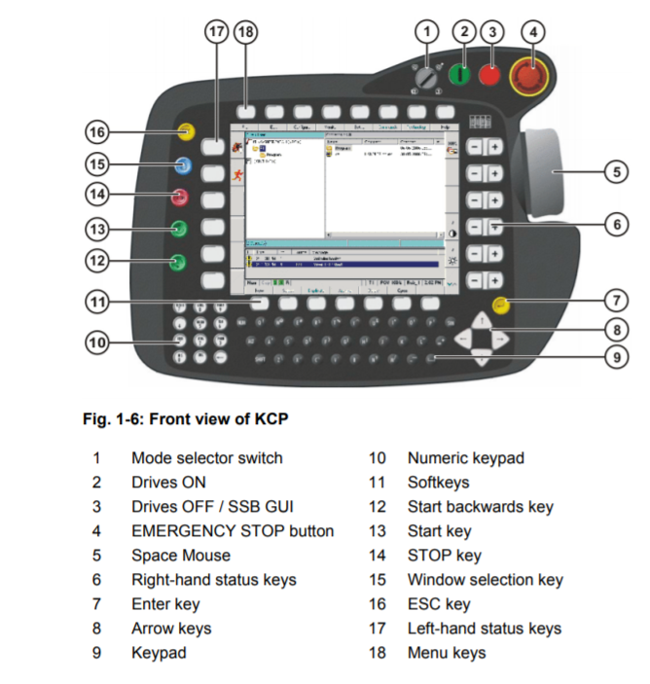
Background
HMI is the interaction point between a human and a robot
The design and features of a HMI determine how much time does a user require to learn to use a robot
Small and medium manufacturers are concerned with having low training times for robots that are going to be used by users with no prior experience with robots
Figure 2 – Example of a HMI industrial controller
NIST Engineering Laboratory
Notes:
HMI controllers with high-complexity controls are less likely to be invested in using a robot
The primary target for these systems are systems that are going to be used by users with at least a high-school level of education but no prior experience with a robot
The more understandable a system is to an inexperienced user, the more likely it is that they will be able to use it

Slide 4
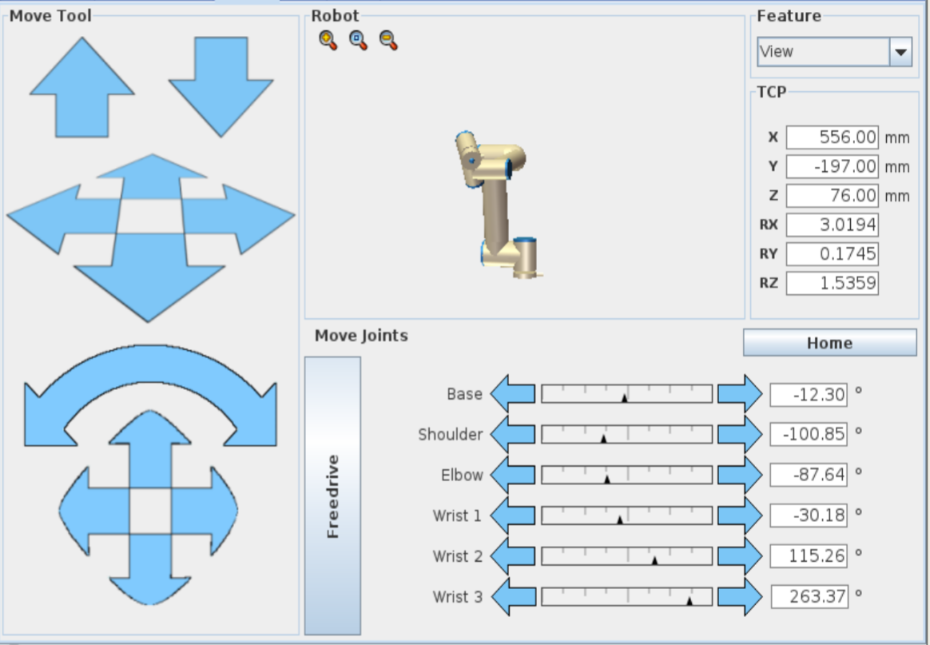
Figure 3 – Interface layout for an industrial robot
NIST Engineering Laboratory
Notes:
This is showcasing a controller for a modern industrial robot.

Slide 5
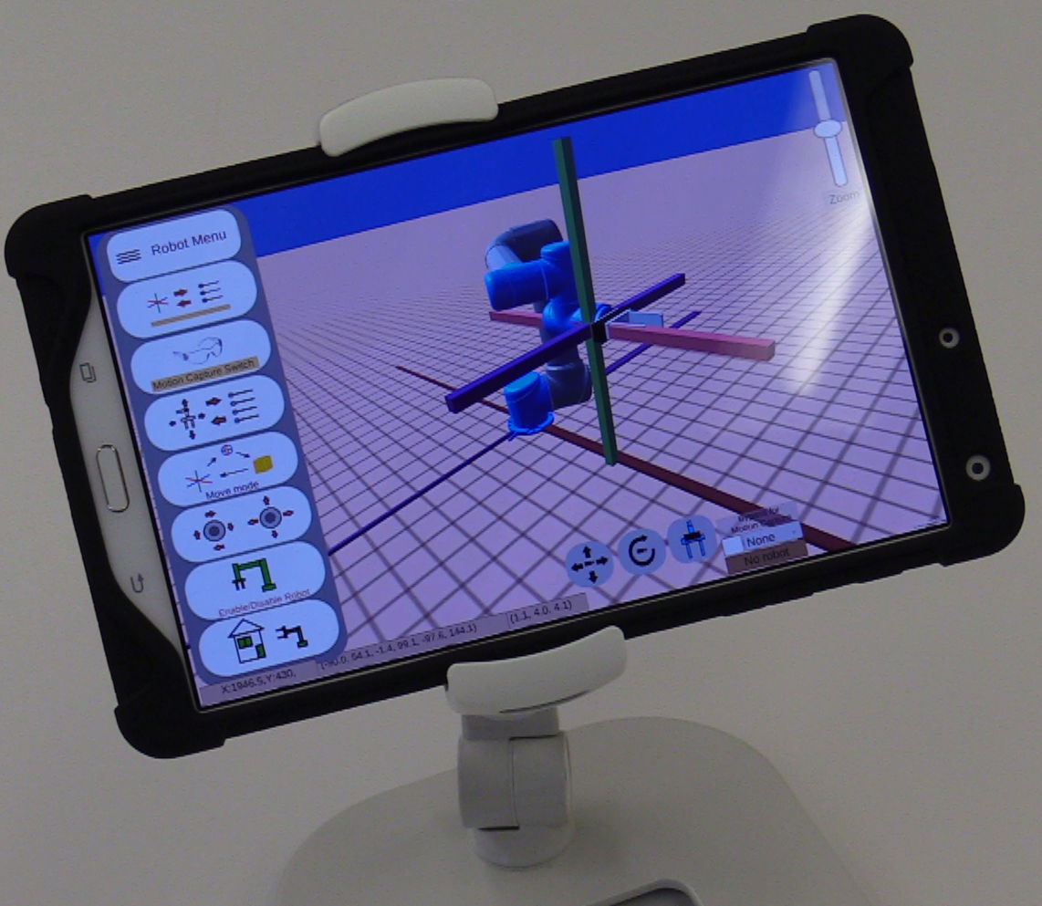
Objective
Recreate industrial controllers with different layouts and features in a user interfaces
Quantify the user experience while utilizing the user interface (UI)
Through application of an industrial case study, determine the performance between the application of different UI
Figure 4 – Controller interface
NIST Engineering Laboratory
Notes:
The primary goal of this project was to be able to re-create industrial controllers with the features they contain and be able to track the user’s actions as they use it
Quantification of the project is done through measuring the user’s intent as they are using the user interface.

Slide 6
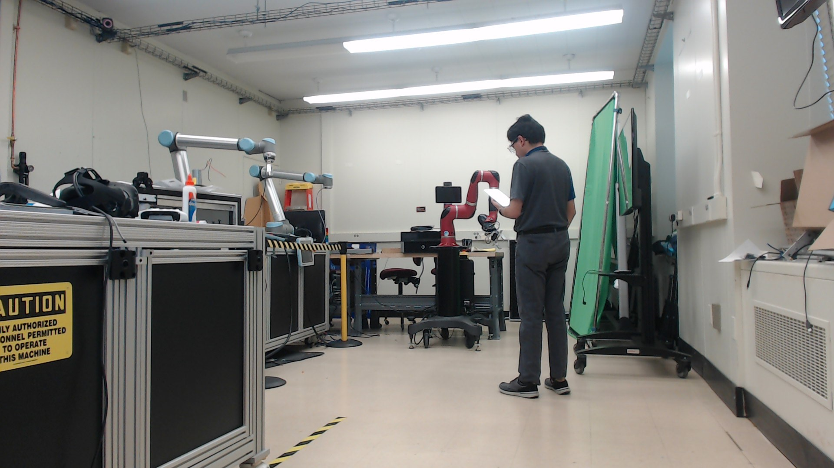
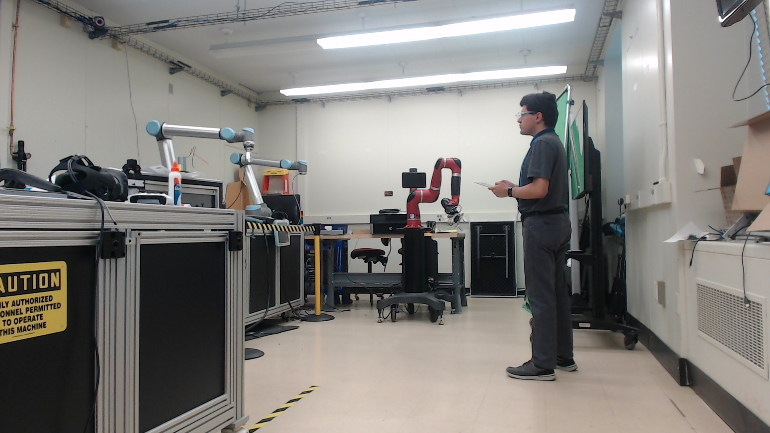
Methodology
Are the controls and robot enabled?
Are my controls being acknowledged?
Figure 5 – A user asks if the robot is enabled
Figure 6 – A user requests feedback
NIST Engineering Laboratory
Notes:
To determine good quantitative metrics for HMI, different types of interfaces should be designed. These interfaces should allow the user to experience different features of the interaction or task.
Researchers can determine what features of control, feedback, and overall layout would work most effectively for users using the interface by experimenting with different layouts and measuring for one of the following metrics
Effectiveness
Efficiency
Reaction time
Precision of control
Researchers can test for these metrics by presenting a user interface to a novice or people with no prior experience to an interface with a robot and determine its ease through the reaction the user has.

Slide 7
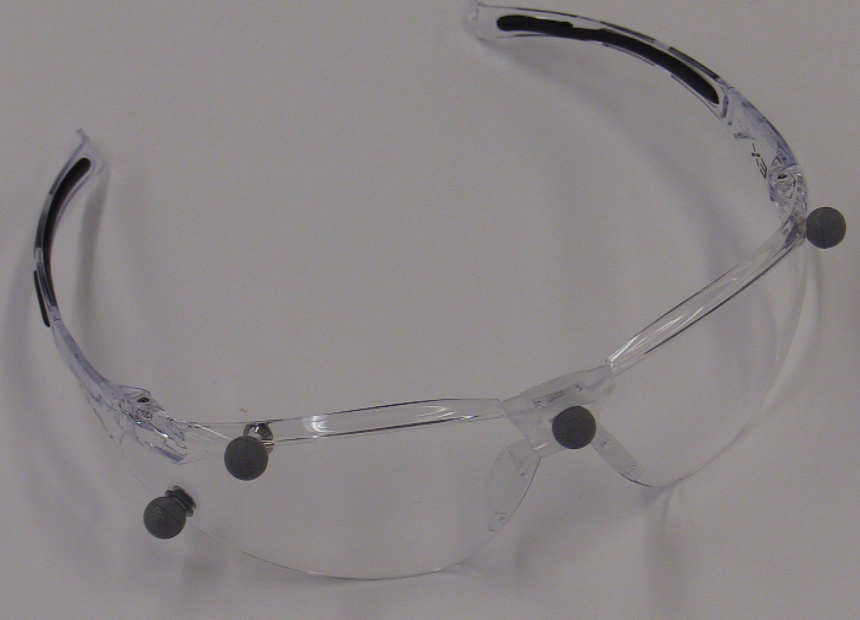
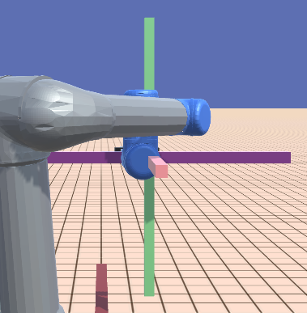
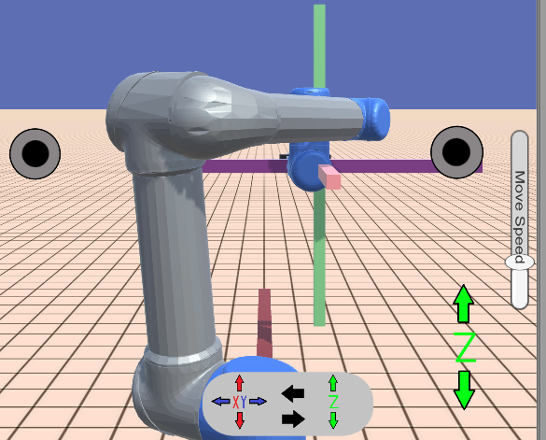
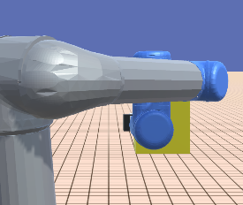
Methodology - Continued
Differences in layout, features, and design influence user experience
Changing the user experience can determine changes in the human-robot interaction
Figure 7 – Motion capture external controls
Figure 8 – XYZ control
Figure 9 – Joystick control
Figure 10 – Free-mode control
NIST Engineering Laboratory

Slide 8
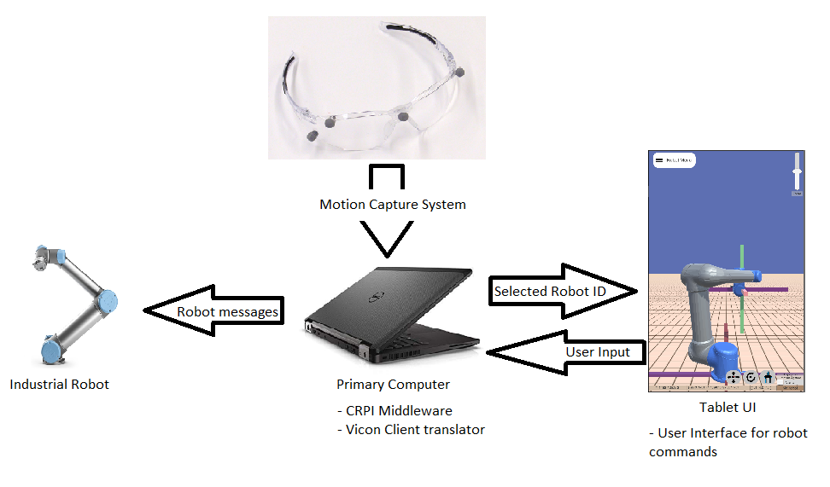
Setup
Figure 11 – System Overview breakdown
NIST Engineering Laboratory
Notes:
Collaborative Robotics Programming Interface (CRPI) allows the computer to relay commands from the tablet to the robot arm
Unity instance calculates the position of items and determines what robot is the user looking at

Slide 9
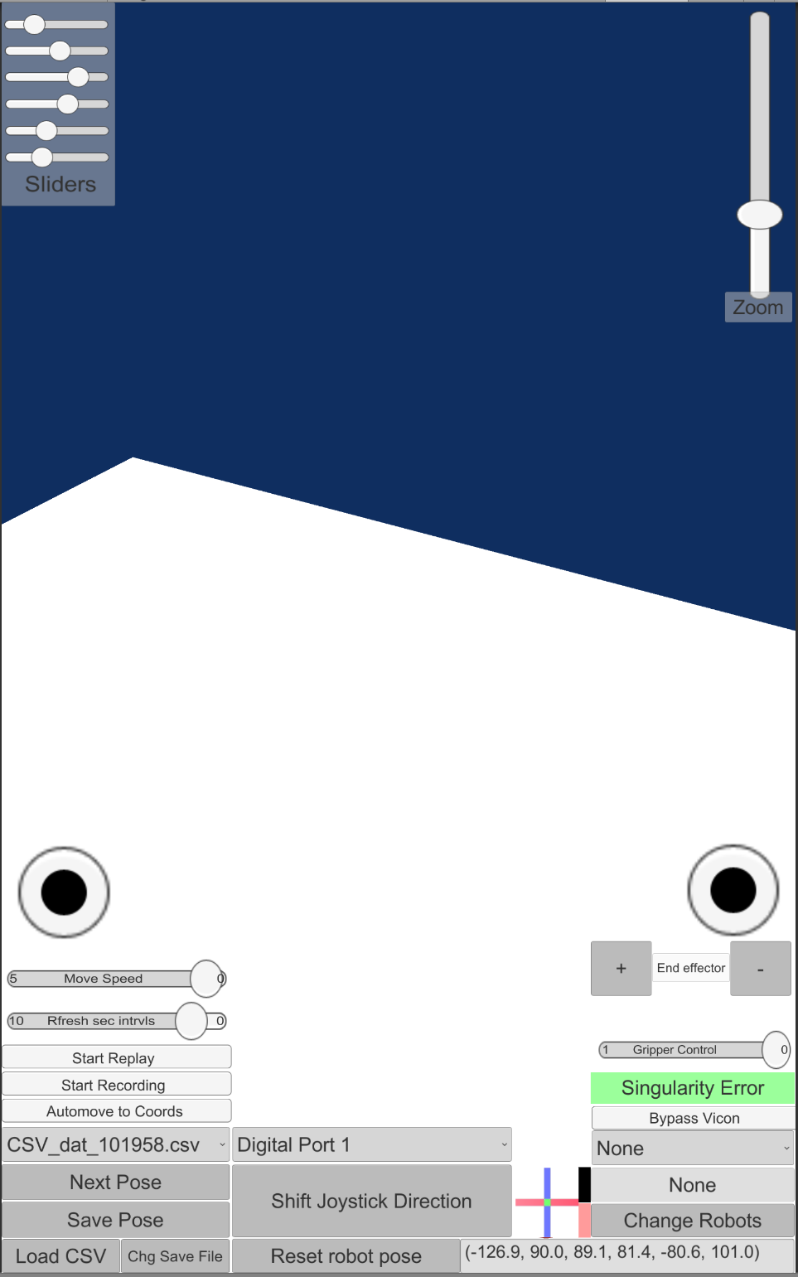
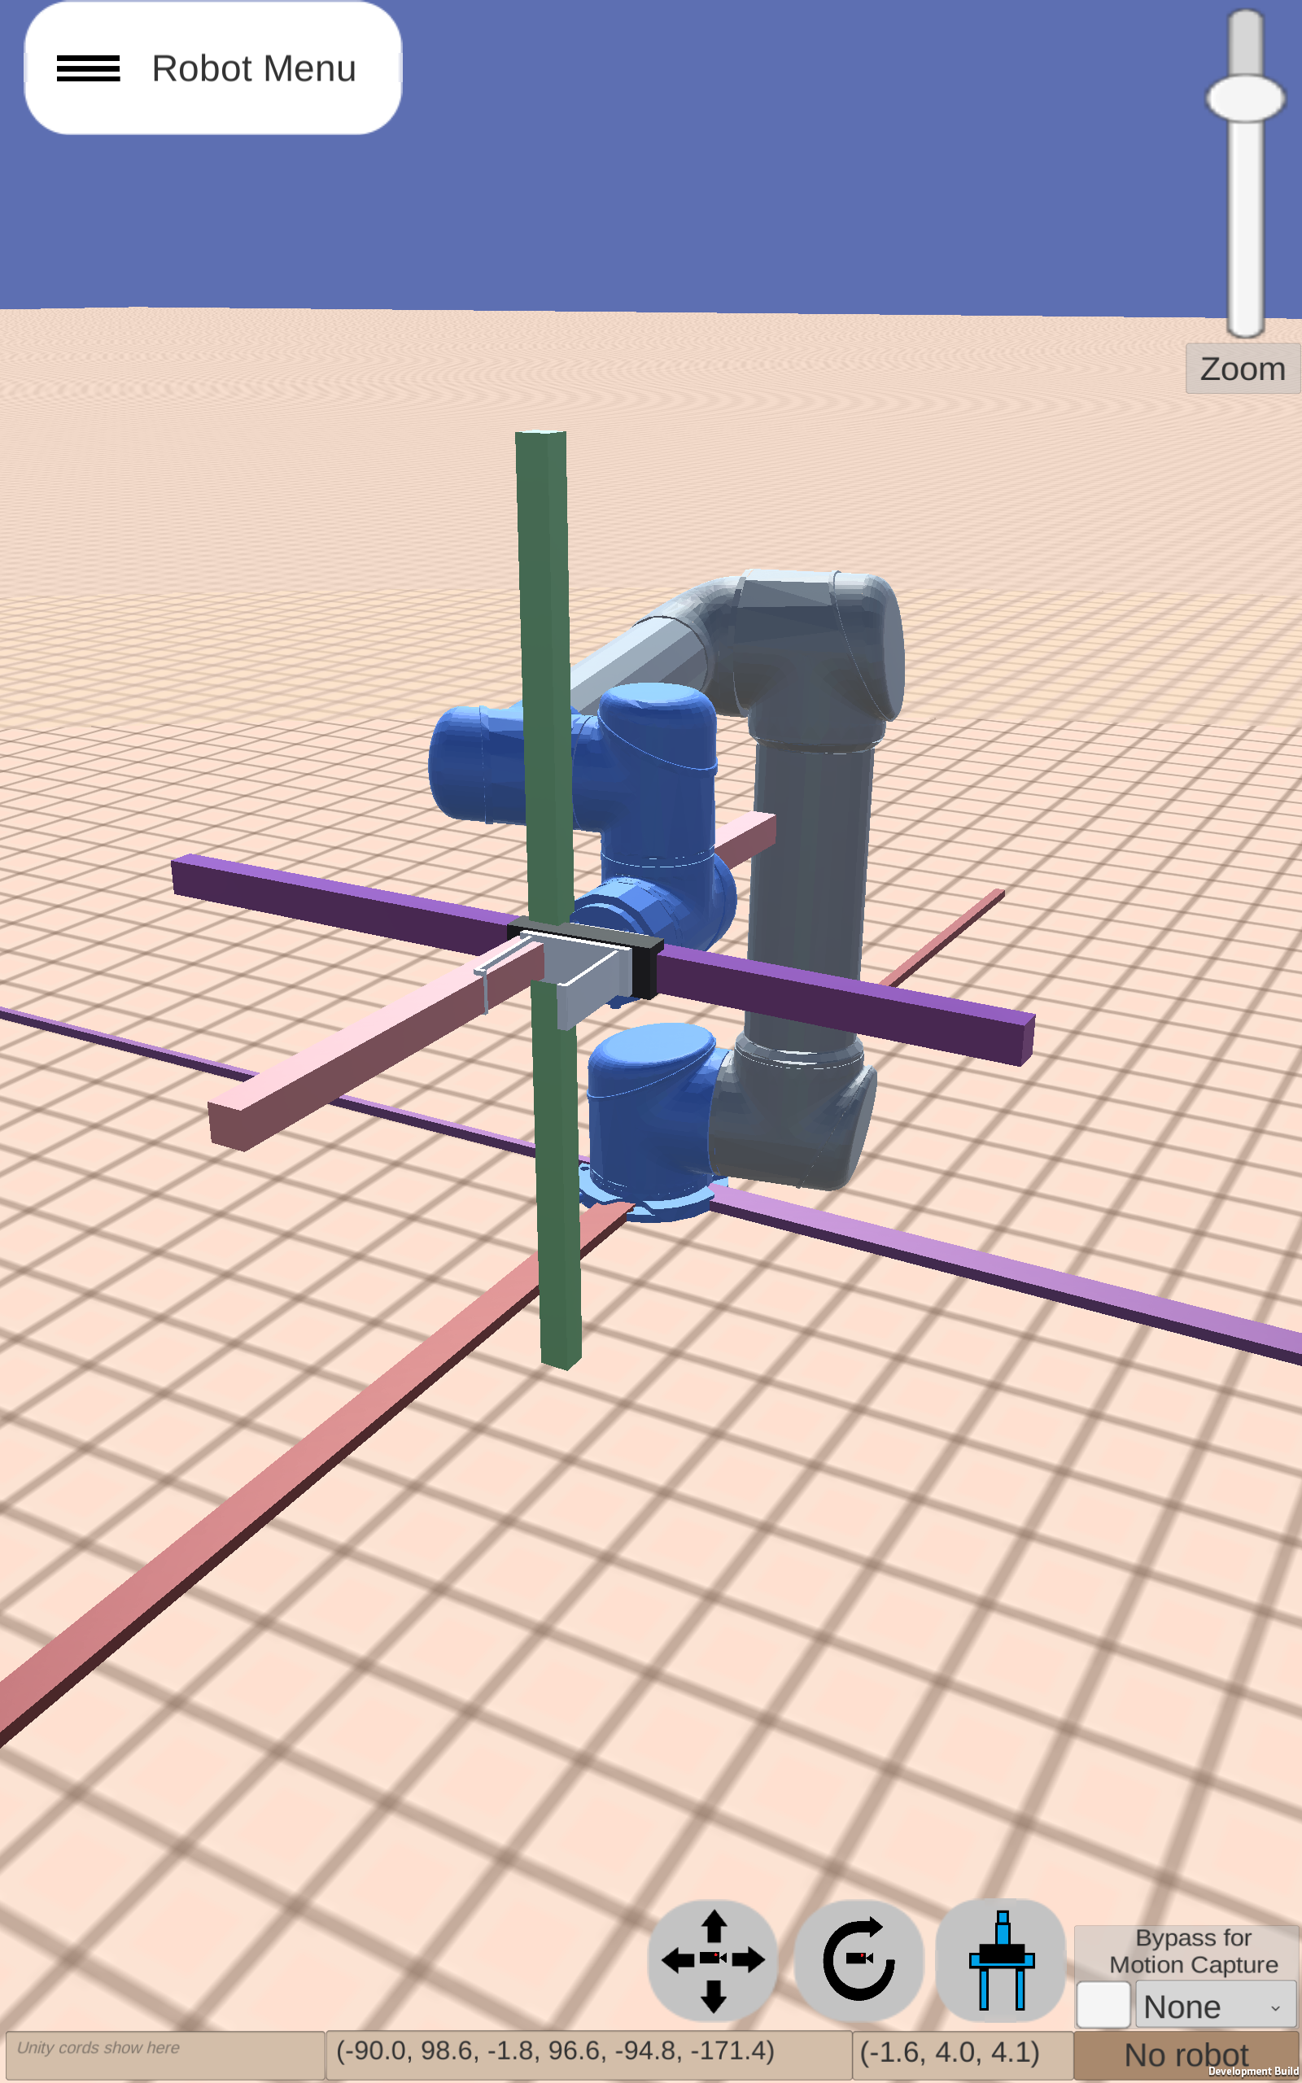
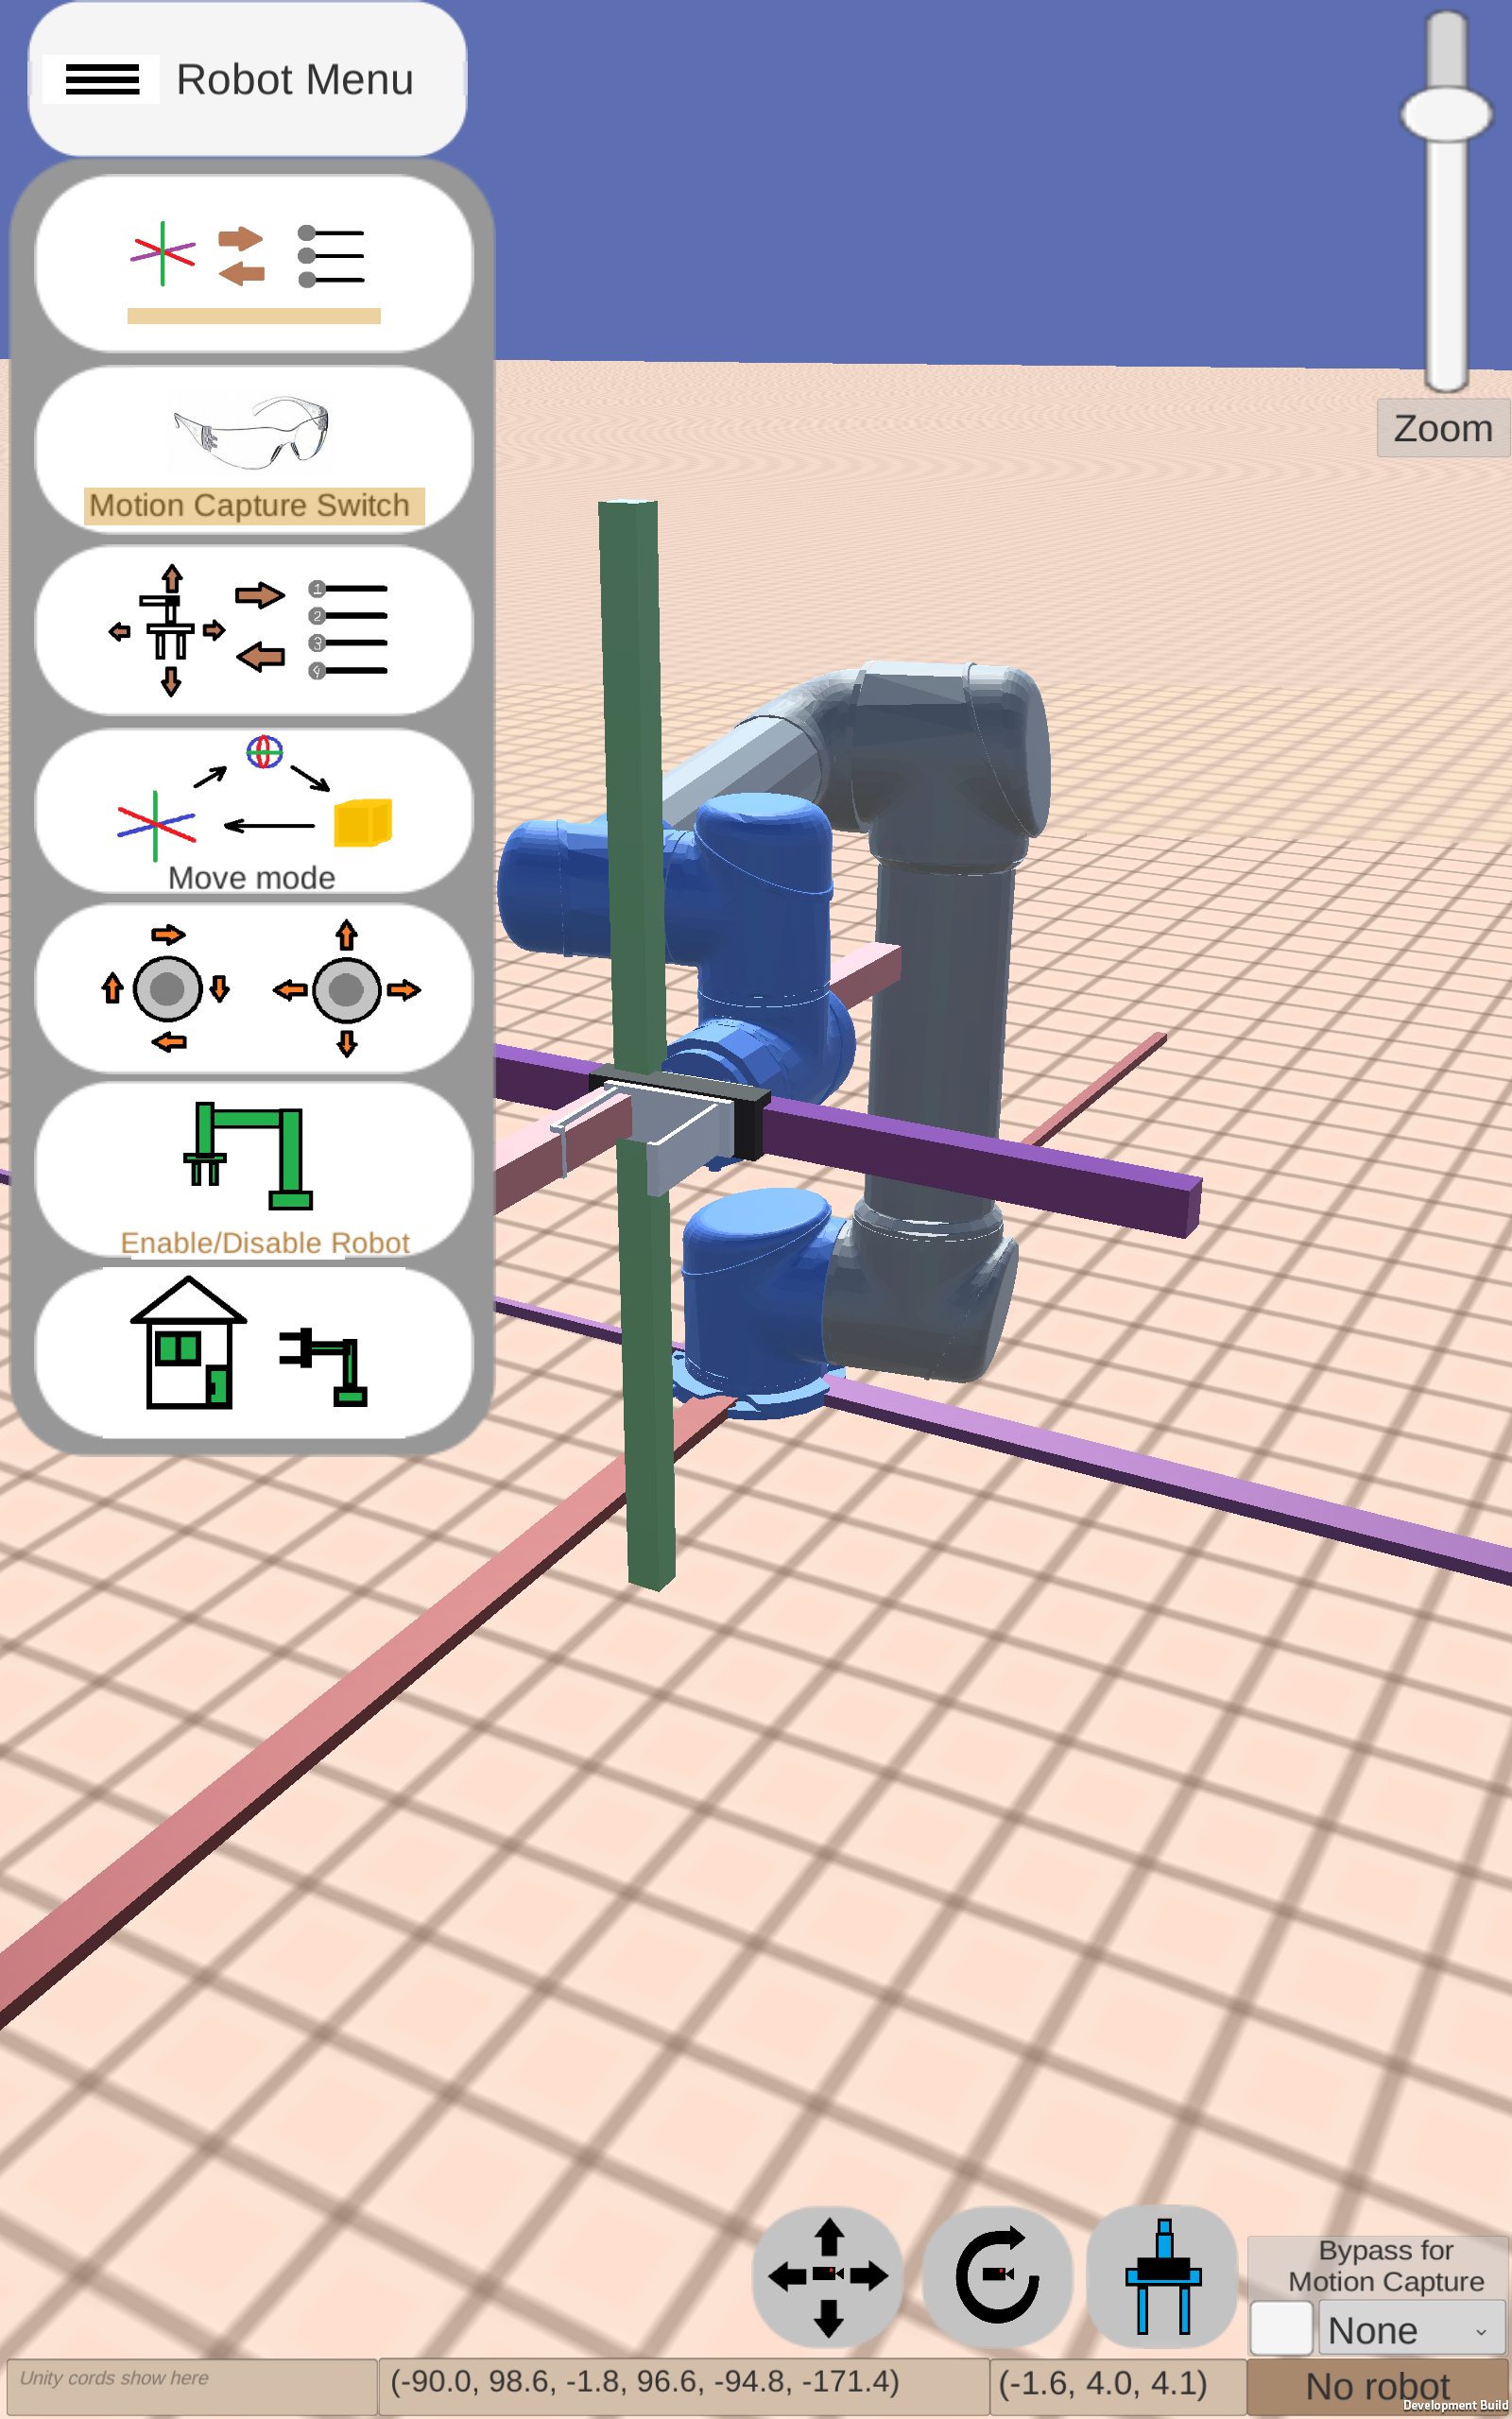
Figure 13 – Example of a first-generation interface
Figure 14 and 15 – Example of a Structured Interface
NIST Engineering Laboratory
Notes:
This is an example of two different interfaces created using this tool, the first one is highly confusing and convoluted while the second interface provides a more clear and concise experience.

Slide 10
Video Demonstration
x8 Speed
NIST Engineering Laboratory
Notes:
In this video the user interface is actively being utilized to control the robot
The robot interface is being shown with the user pressing different buttons to achieve different control schemes to place the green blocks over the stacking points

Slide 11
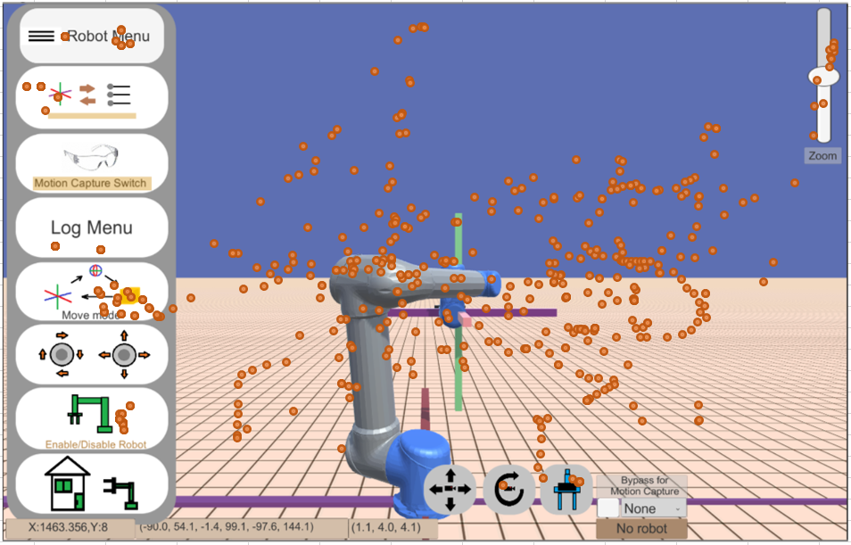
Results
Unity records motions perceived from the tablet such as the position of the touch and which buttons are being pressed
The layout can be changed around as desired with different tasks being applied
Figure 12 – Touchscreen heatmap from user
NIST Engineering Laboratory

Slide 12
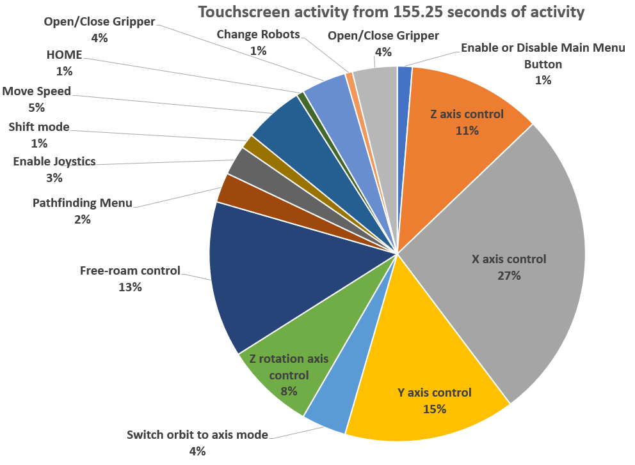
Figure 16 – Touchscreen activity from user in a trial
NIST Engineering Laboratory

Slide 13
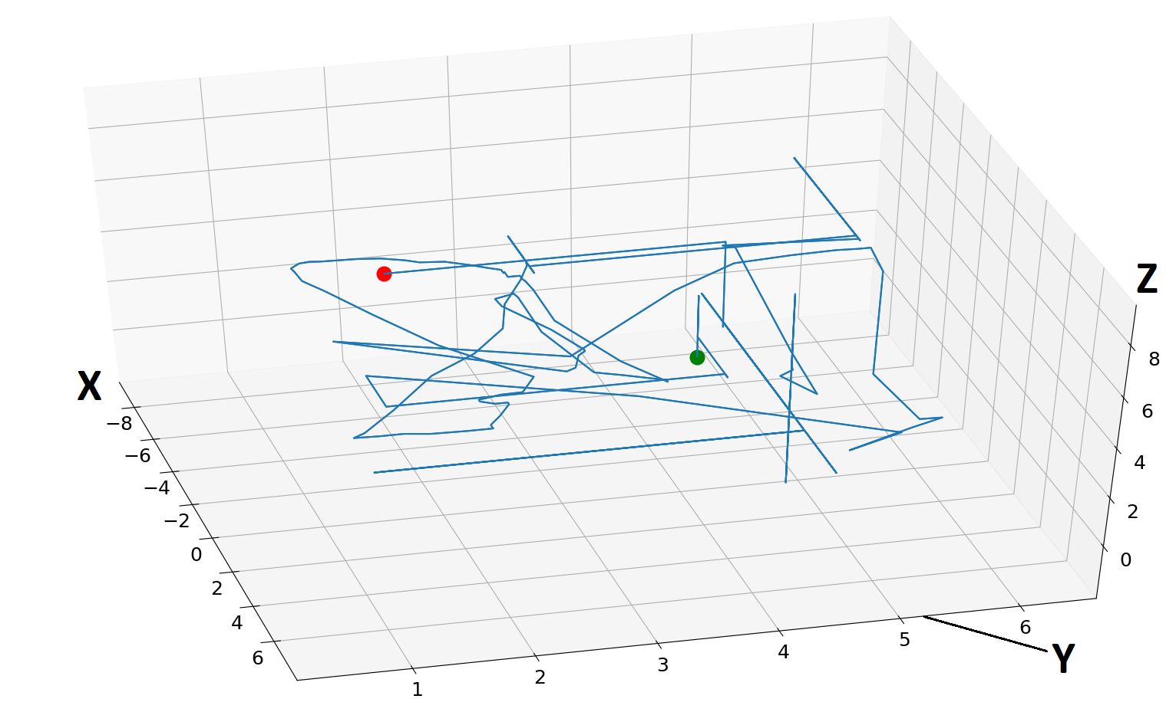
End
Start
Figure 17 – 3D map of end-effector movement as used by the user during a trial.

Slide 14
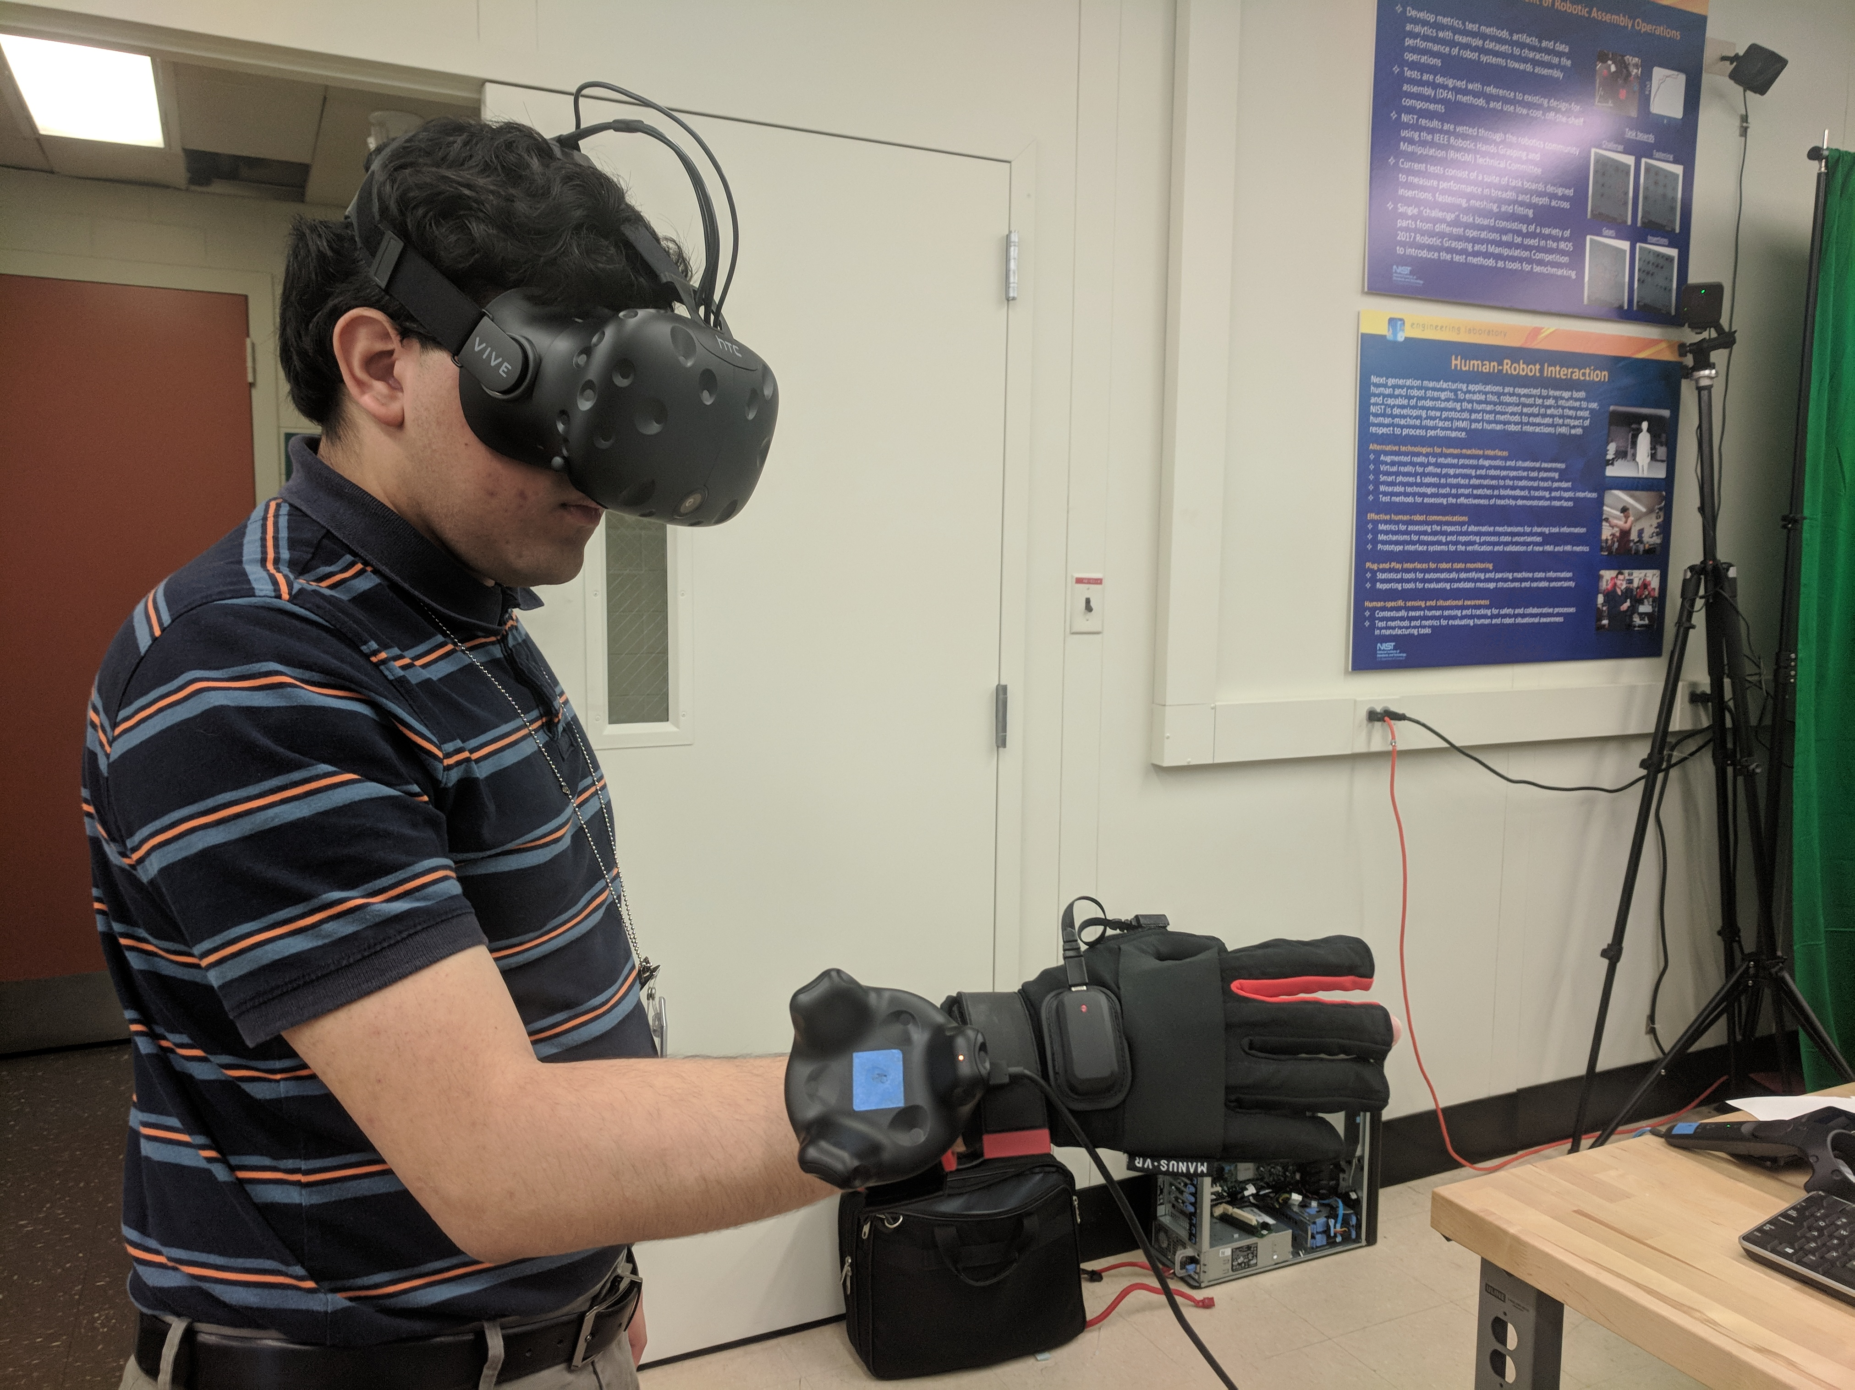
Conclusion and Future Work
Human trials of currently developed HMI to compare performance
The studies will of state-of-the art technologies such as virtual reality, augmented reality, or wearable technologies
This project will be part of the user studies as well
Figure 18 – Examples of future testing equipment including virtual reality and wearable technology
NIST Engineering Laboratory

Slide 15
Questions?
Special thanks to:
Jeremy Marvel
Shelly Bagchi
Megan Zimmerman
Project Files are available on GitHub
https://github.com/usnistgov/CRPI
https://github.com/OvercodedStack/ANDROID_UNITY_UI-Summer-2019-NIST/tree/Android-Branch
https://github.com/OvercodedStack/MOTION_CAPTURE_UNITY-Summer-of-2019-NIST
https://github.com/OvercodedStack/CRPI_MIDDLEWARE_INTEGRATION-Summer-of-2019-NIST
https://github.com/OvercodedStack/CRPI-UI-DOCUMENTATION-Summer-of-2019
Thank you for NIST SURF 2019!

Slide 16
NIST Disclaimer
Certain commercial equipment, instruments, or materials are identified in this paper to foster understanding. Such identification does not imply recommendation or endorsement by the National Institute of Standards and Technology, nor does it imply that the materials or equipment identified are necessarily the best available for the purpose.
NIST Engineering Laboratory

Slide 17
References for Images
Amazon.com for image for Latitude E5570
Universal Robotics for UR5 image
NIST Engineering Laboratory

Slide 18
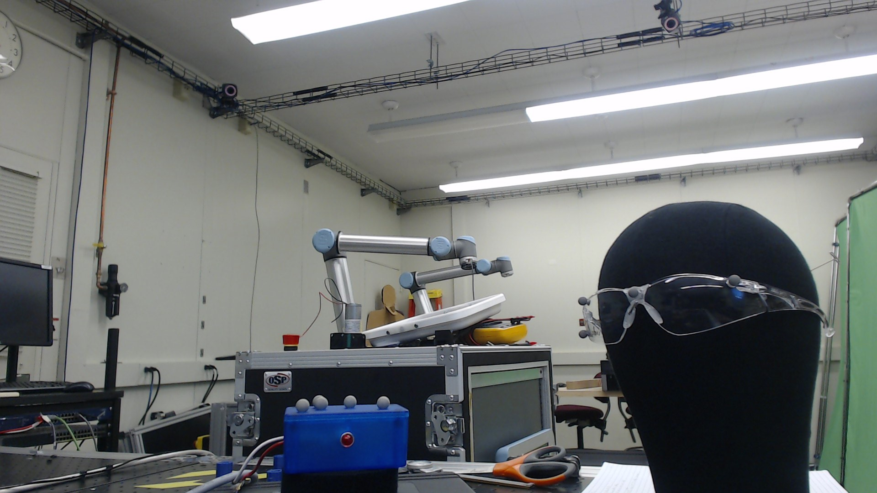
Motion Capture Setup
Motion Capture System
Motion Capture Objects
Figure 19 – Motion capture parts
NIST Engineering Laboratory

